Slide 1




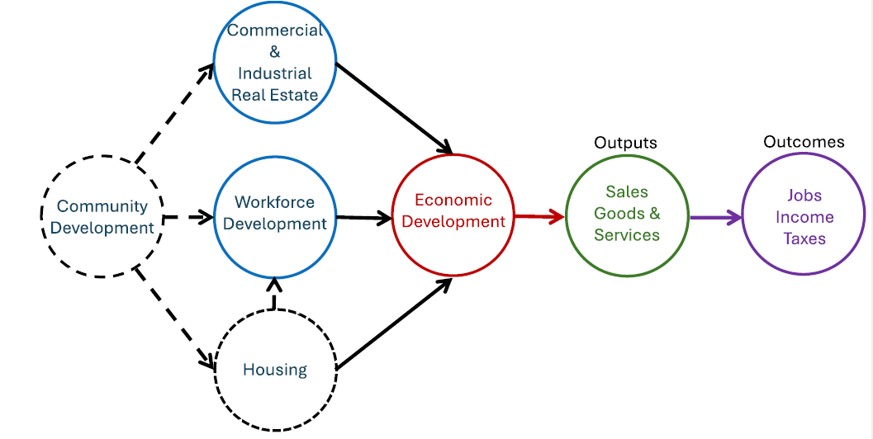
STARK COUNTY GOVERNMENTAL LAW SEMINAR
February 28, 2026
INTRODUCTION STEPHEN MACKENZIE
STARK ECONCOMIC DEVELOPMENT BOARD OVERVIEW STEHPHEN MACKENZIE
HOUSING STRATEGY TODD HAWKE
QUESTIONS
Notes:
Two primary functions: attract new businesses to Stark County and help existing companies expand. We want companies that exist or those moving to Stark County to create more jobs so that they can create and sell more of their product or services. This leads to more payroll and property tax for the community and more disposable income for the residents.
The focus of our organization on companies that export goods and services and import dollars back into Stark County is a very important principle to economic development.

Slide 2

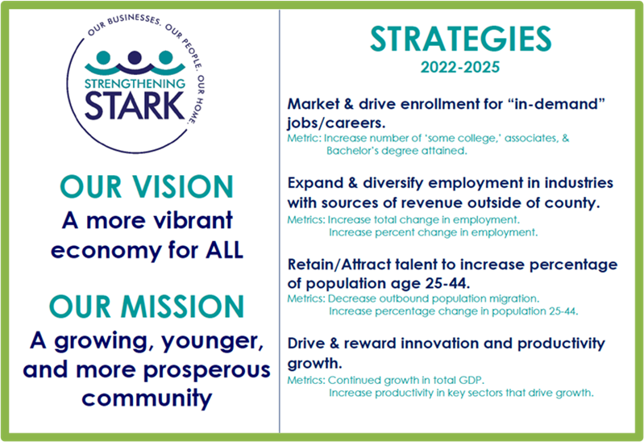
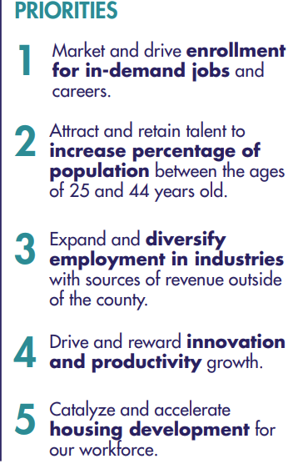
Who We Are
Notes:
Two primary functions: attract new businesses to Stark County and help existing companies expand. We want companies that exist or those moving to Stark County to create more jobs so that they can create and sell more of their product or services. This leads to more payroll and property tax for the community and more disposable income for the residents.
The focus of our organization on companies that export goods and services and import dollars back into Stark County is a very important principle to economic development.

Slide 3



Slide 4
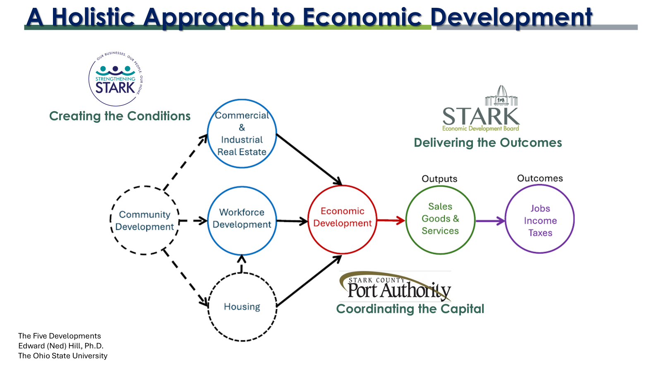
SEDB Holistic Approach to Economic Development
Notes:
Two primary functions: attract new businesses to Stark County and help existing companies expand. We want companies that exist or those moving to Stark County to create more jobs so that they can create and sell more of their product or services. This leads to more payroll and property tax for the community and more disposable income for the residents.
The focus of our organization on companies that export goods and services and import dollars back into Stark County is a very important principle to economic development.

Slide 5


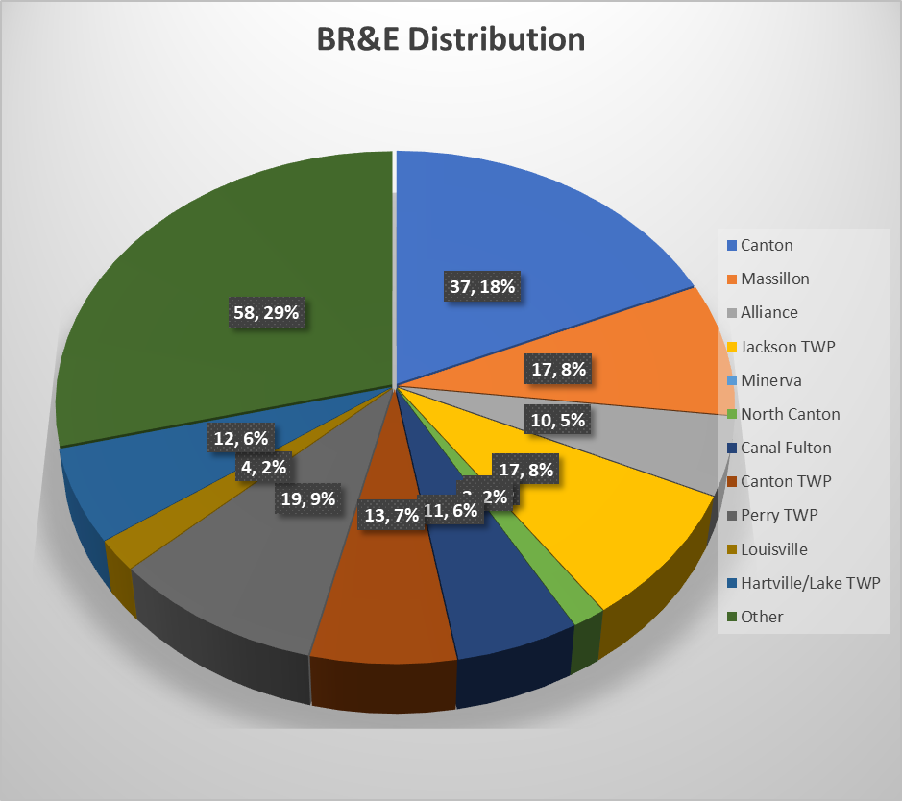
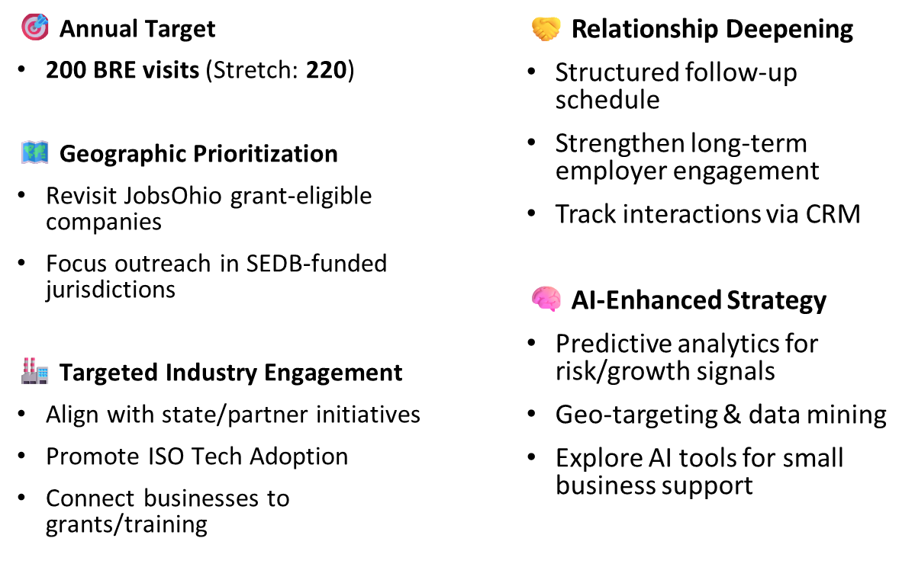
Reminder: Company and Project Information is Confidential and not for Public Release
Canton | 37
Massillon | 17
Alliance | 10
Jackson TWP | 17
Minerva | 0
North Canton | 3
Canal Fulton | 11
Canton TWP | 13
Perry TWP | 19
Louisville | 4
Hartville/Lake TWP | 12
Other | 58
TOTAL | 203
203/200 BREs Completed (as of 31DEC)
200 by EOM DEC
BRE Focus:

Slide 6
2025 Business Outreach and Project Metrics
Companies Visited | State Support Secured | New Jobs Committed | New Payroll Committed | Capital Expenditures
200 | $4,000,000 | 575 | $23,930,000 | $96,000,000
203 | $985,000 / 24.6% $4M JobsOhio Loan | 166 / 28.8% | $10,762,000 / 44.9% | $30,136,647/ 31.4%
202 | $9,323,000 | 639 | $36,025,428 | $134,902,168
(2025 Goals)
(As of 31DEC)
(2024 Results)

Slide 7

Stark county Housing Strategy

Slide 8

Stark county housing needs analysis
Why the housing study?

Slide 9

Stark county housing needs analysis
What is in the study?
At a median income of $63,000 a median home value of $200,000 is unaffordable
  Median income earners can only afford homes priced at $135,000
There is an income gap, workers need to earn $25,000 more annually to afford the $200,000 home
MOST RECENT VALUES
Median Income: $69,000 (+9.96%)
Median Home Sold Price: $227,300 (+13.65%)
Median Home Listing Price: $249,000 (+24.5%)

Slide 10
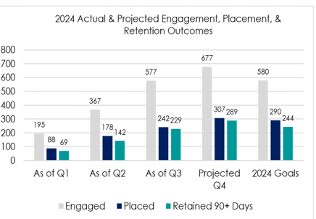
Stark county housing needs analysis
SEDB METRIC REVIEW AND TRACKING 2024 (As of 29 JAN 2025)
CAREER CONNECT TRACKING 2024
Year | Companies Visited | State Support Secured | New Jobs Committed | New Payroll Committed | Capital Expenditures
2024 | 202 | $9,323,000 | 639 | $36,025,428 ($27/hr.) | $134,907,168
SINCE 2020 | 1021 | $32,725,398 | 3540 | $173,476,166 ($23/hr.*) | $575,035,479
*Not adjusted for inflation
Average Annual Wage = $56,160 ($27.00/hr)
Average Annual Wage = $34,000 ($16.35/hr)

Slide 11
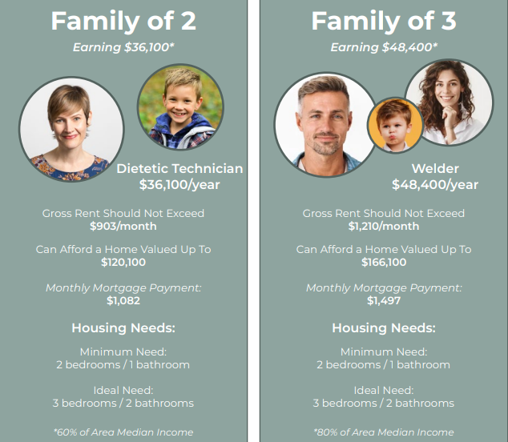
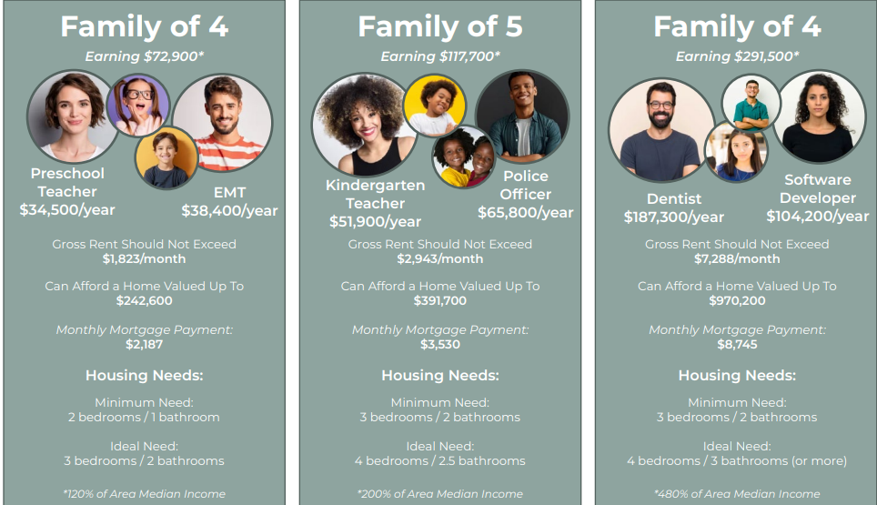

Stark county housing needs analysis
What do our workforce households look like?

Slide 12










STARK COUNTY HOUSING STRATEGY
FAMILY OF 2
FAMILY OF 3
FAMILY OF 4
Nursing Assistant
$38,570 / Year*
Mechanical Engineering Technician
$65,590 / Year*
Welder
$49,510 / Year
Licensed Practical Nurse
$57,666 / Year
Monthly Gross Income
$3,214 / Month
Hourly Income
$18.54 / Hour
*60% of Area Median Household Income
Monthly Gross Income
$5,465 / Month
Hourly Income
$31.54 / Hour
*95% of Area Median Household Income
Annual Gross Income
$107,170 / Year*
Monthly Gross Income
$8,930 / Month
Hourly Income
$51.52 / Hour
*120% of Area Median Household Income
Maximum Affordable Housing Cost
$870 / Month
Maximum Affordable Housing Cost
$1,237 / Month
Maximum Affordable Housing Cost
$1,890 / Month
Notes:
This slide may be omitted if group is familiar with the evolution of SS
Speaker notes to be added

Slide 13
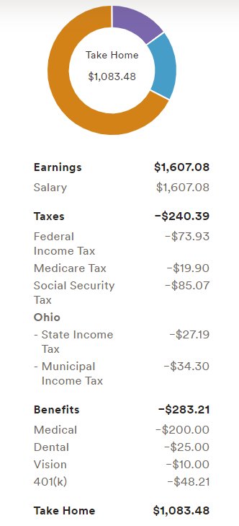


STARK COUNTY HOUSING STRATEGY
FAMILY OF 2
Nursing Assistant
$38,570 / Year*
Monthly Gross Income
$3,214 / Month
Hourly Income
$18.54 / Hour
*60% of Area Median Household Income
Maximum Affordable Housing Cost
$870 / Month
Notes:
This slide may be omitted if group is familiar with the evolution of SS
Speaker notes to be added

Slide 14
STARK COUNTY HOUSING STRATEGY
FAMILY OF 2
Rental Housing
Home Ownership
Nursing Assistant
$38,570 / Year*
Monthly Net Income
$2,167
Monthly Net Income
$2,167
Monthly Gross Income
$3,214 / Month
Hourly Income
$18.54 / Hour
*60% of Area Median Household Income
Housing Cost
$870
Housing Cost
$1,000
Car Payment
$527
Car Payment
$527
Childcare
$980
Childcare
$980
Groceries
$540
Groceries
$540
Maximum Affordable Housing Cost
$870 / Month
Utilities
$350
Utilities
$450
Other (Cell Phone, Internet, Car Insurance, Gas, etc)
Other (Cell Phone, Internet, Car Insurance, Gas, etc)
$410
$410
NET
$1,510
NET
$1,740
Notes:
This slide may be omitted if group is familiar with the evolution of SS
Speaker notes to be added

Slide 15
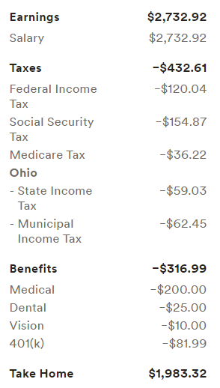


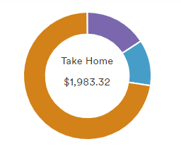

STARK COUNTY HOUSING STRATEGY
FAMILY OF 3
Mechanical Engineering Technician
$65,590 / Year*
Monthly Gross Income
$5,465 / Month
Hourly Income
$31.54 / Hour
*95% of Area Median Household Income
Maximum Affordable Housing Cost
$1,237 / Month
Notes:
This slide may be omitted if group is familiar with the evolution of SS
Speaker notes to be added

Slide 16
STARK COUNTY HOUSING STRATEGY
FAMILY OF 3
Rental Housing
Home Ownership
Mechanical Engineering Technician
$65,590 / Year*
Monthly Net Income
Monthly Net Income
$3,966
$3,966
Housing Cost
$1,063
Housing Cost
$1,666
Monthly Gross Income
$5,465 / Month
Hourly Income
$31.54 / Hour
*95% of Area Median Household Income
Car Payment
$1,054
Car Payment
$1,054
Childcare
$0
Childcare
$0
Groceries
$1,052
Groceries
$1,052
Maximum Affordable Housing Cost
$1,237 / Month
Utilities
$550
Utilities
$550
Other (Cell Phone, Internet, Car Insurance, Gas, etc)
Other (Cell Phone, Internet, Car Insurance, Gas, etc)
$700
$700
Net
$403
Net
$1,056
Notes:
This slide may be omitted if group is familiar with the evolution of SS
Speaker notes to be added

Slide 17
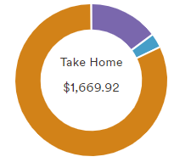
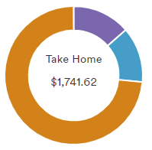

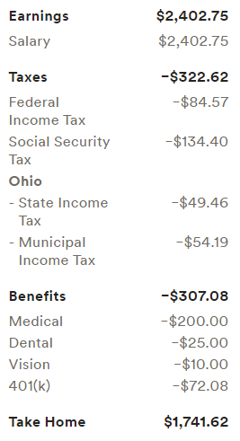
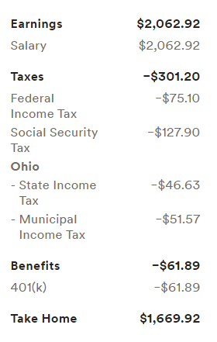

STARK COUNTY HOUSING STRATEGY
FAMILY OF 4
Welder
$49,510 / Year
Licensed Practical Nurse
$57,666 / Year
Annual Gross Income
$107,170 / Year*
Monthly Gross Income
$8,930 / Month
Hourly Income
$51.52 / Hour
*120% of Area Median Household Income
Maximum Affordable Housing Cost
$1,890 / Month
Notes:
This slide may be omitted if group is familiar with the evolution of SS
Speaker notes to be added

Slide 18
STARK COUNTY HOUSING STRATEGY
FAMILY OF 4
Rental Housing
Home Ownership
Welder
$49,510 / Year
Licensed Practical Nurse
$57,666 / Year
Monthly Net Income
Monthly Net Income
$6,823
$6,823
Housing Cost
$1,100
Housing Cost
$2,030
Car Payment
$1,265
Car Payment
$1,265
Annual Gross Income
$107,170 / Year*
Monthly Gross Income
$8,930 / Month
Hourly Income
$51.52 / Hour
*120% of Area Median Household Income
Childcare
$1,280
Childcare
$1,280
Groceries
$1,252
Groceries
$1,252
Maximum Affordable Housing Cost
$1,890 / Month
Utilities
$600
Utilities
$650
Other (Cell Phone, Internet, Car Insurance, Gas, etc)
Other (Cell Phone, Internet, Car Insurance, Gas, etc)
$750
$750
Net
$525
Net
$443
Notes:
This slide may be omitted if group is familiar with the evolution of SS
Speaker notes to be added

Slide 19

Shortage of available units
INCOME BRACKETS | HOUSING UNITS NEEDED
$35,000 – $49,999 | 5,136
$50,000 – $74,999 | 2,981
$75,000 – $99,999 | 4,760
TOTAL |  |  | 12,877*
*Based on certain assumptions and conditions; subject to change

Slide 20
Stark county housing PLAN
Primary Goal: Eliminate the housing imbalance in the targeted segment for Stark County’s workforce within the income range of $35,000 - $100,000 by 2030.
DOING NOTHING IS NOT AN OPTION!

Slide 21
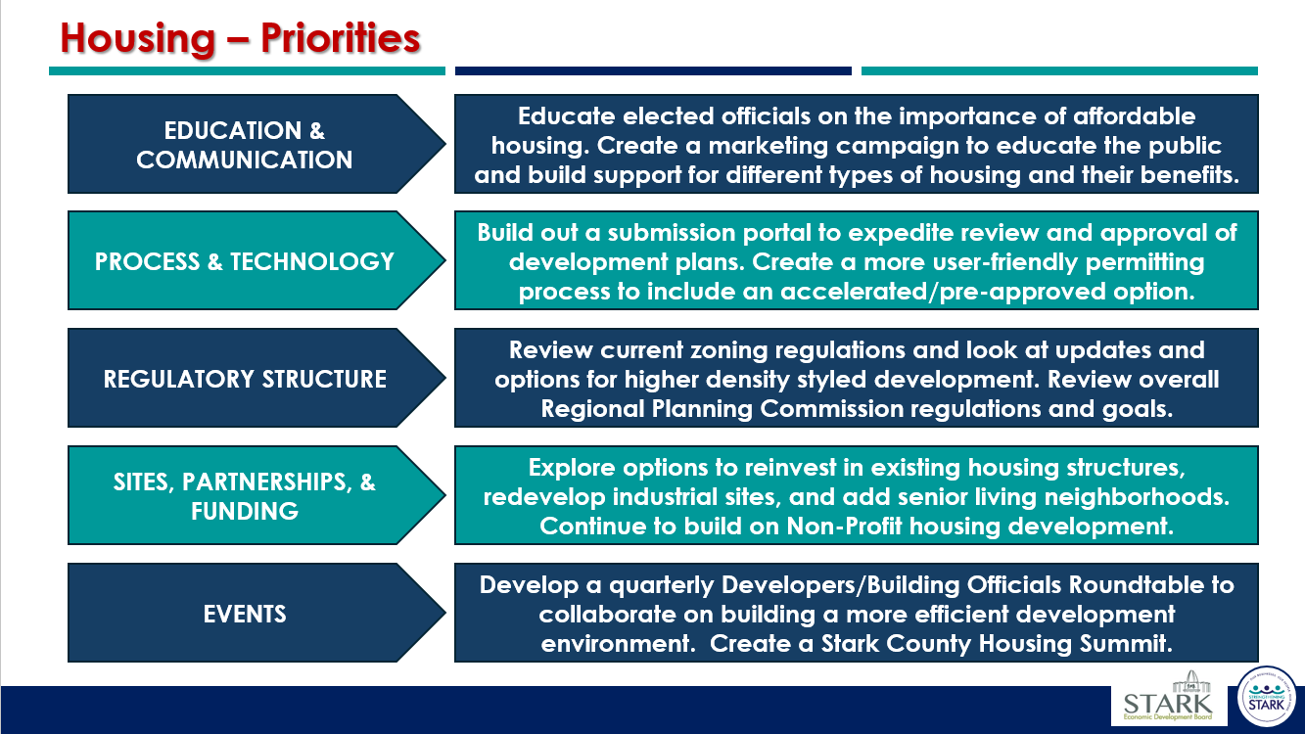

Stark county housing needs analysis
How do we do it?
Execute action plans around the 9 high level study recommendations
  Grouped into 5 main priorities for Working Teams
Create, build, and maintain community momentum

Slide 22
Housing priorities
EDUCATION & COMMUNICATION
Educate elected officials on the importance of affordable housing. Create a marketing campaign to educate the public and build support for different types of housing and their benefits.
Meetings with 10 local governments to discuss issues and priorities
Meeting with Countywide School Superintendents
Community meeting with expert speakers and strategy updates, approximately 150 attendees
Communications plan outlined and assets are being created
  Op-Eds
  Blog Posts
  Videos
Creating case studies to demonstrate costs and timelines

Slide 23
Housing priorities
PROCESS & TECHNOLOGY
Build out a submission portal to expedite review and approval of development plans. Create a more user-friendly permitting process to include an accelerated/pre-approved option.
Researching vendors to establish an online submission portal for plans to review, approve, and issue permits from start to finish of a project
Reviewing processes to create efficiencies and avoid delays
Look into processes to renovate properties that distressed within existing neighborhoods

Slide 24
Housing priorities
REGULATORY STRUCTURE
Review current zoning regulations and look at updates and options for higher density styled development. Review overall Regional Planning Commission regulations and goals.
Reviewing opportunities on ways to create best practices in zoning
Discussions around information to provide to the Education & Communications Woking Team to buildout assets
Take information learned in Quarterly Roundtables to create options and opportunities to assist in longer term planning

Slide 25
Housing priorities
SITES, PARTNERSHIPS, & FUNDING
Explore options to reinvest in existing housing structures, redevelop industrial sites, and add senior living neighborhoods. Continue to build on Non-Profit housing development.
Sites Inventory and Strategy Initiative – Sites for both Industrial/Commercial and Residential Development
Build on current Non-Profit housing success to increase volume
Look at opportunities to create senior living options to allow for more turnover of existing home inventory
Establish additional funding assistance and methods for development, home ownership, and rentals
Create more local options for partnerships

Slide 26
Housing priorities
EVENTS
Develop a quarterly Developers/Building Officials Roundtable to collaborate on building a more efficient development environment. Create a Stark County Housing Summit.
Establish a Quarterly Roundtable to connect the regulatory sectors with the development sector – FIRST MEETING MARCH 3, 2026
Discussions on ways to be in front of or create more general community events for education and input
Establish a Stark County Housing Summit – Looking to initiate in 2027
  Connecting with other areas in the country that have held these
  Establishing how the meetings could breakout into various topics

Slide 27
QUESTIONS??

Slide 28
Thank you!
Todd Hawke
todd@starkcoohio.com
Stephen MacKenzie
stephen@starkcoohio.com

